Slide 1
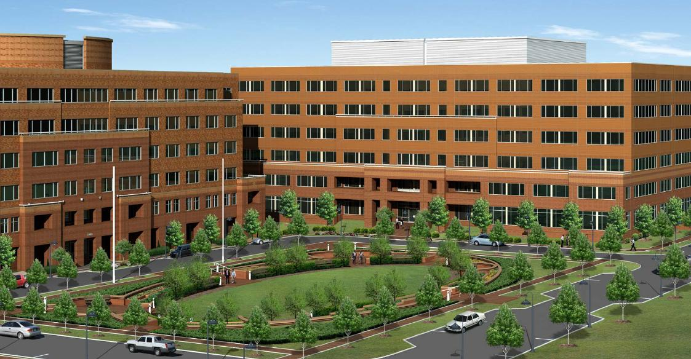
M I l e s t o n e B u I l d I n g # 4
Kristen Marie Hlopick
Construction Management
Germantown, Maryland
Dr. David Riley

Slide 2
O v e r v I e w
Introduction Project Background
Critical Research LEED Guide for Trade Contractors
Architectural Breadth Interior Tenant Fit Out
Structural Breadth Parking Garage
Acknowledgements
Questions
M i l e s t o n e B u i l d i n g # 4
K r i s t e n M H l o p i c k
Construction Management | Dr. David Riley | Germantown, Maryland | April 15, 2008

Slide 3
I n t r o d u c t I o n
Project Background
Introduction
Project Background
M i l e s t o n e B u i l d i n g # 4
K r i s t e n M H l o p i c k
Construction Management | Dr. David Riley | Germantown, Maryland | April 15, 2008

Slide 4
I n t r o d u c t I o n
Project Background
Location: Milestone Business Park, Germantown Maryland
LEED Certified: Core and Shell Silver Certification
Occupancy: WeatherBug ® Office Space
Size: 166,292 SF
Number of Stories: Six
Schedule: June 29, 2007 – September 30, 2008 (15 Months)
Cost: ~$19 Million, LEED CO of $478,000
Project Delivery Method: Design Bid Build
M i l e s t o n e B u i l d i n g # 4
K r i s t e n M H l o p i c k
Construction Management | Dr. David Riley | Germantown, Maryland | April 15, 2008

Slide 5
I n t r o d u c t I o n
Project Background
Project Team
Owner: Kennedy Associates
Developer: Trammell Crow Company
Leaser: CB Richard Ellis
Architect: Morgan Gick McBeath and Associates
Contractor: Buch Construction
M i l e s t o n e B u i l d i n g # 4
K r i s t e n M H l o p i c k
Construction Management | Dr. David Riley | Germantown, Maryland | April 15, 2008

Slide 6
R e s e a r c h
LEED Guide for trade Contractors
Critical Research
LEED Guide for Trade Contractors
M i l e s t o n e B u i l d i n g # 4
K r i s t e n M H l o p i c k
Construction Management | Dr. David Riley | Germantown, Maryland | April 15, 2008

Slide 7
R e s e a r c h
LEED Guide for trade Contractors
Problem Statement
All new construction must be LEED certified
Lack of knowledge with trade contractors
Unable to fulfill LEED requirements
Goal
First time users
MR 2, MR 4, MR 5
Information Pamphlet
LEED Guide for Trade Contractors
M i l e s t o n e B u i l d i n g # 4
K r i s t e n M H l o p i c k
Construction Management | Dr. David Riley | Germantown, Maryland | April 15, 2008

Slide 8
R e s e a r c h
LEED Guide for trade Contractors
Procedure
Create a survey
Develop LEED Information Pamphlet
Develop LEED Guide for Trade Contractors
Test pamphlet and guide
Process survey results
Make any necessary adjustments
M i l e s t o n e B u i l d i n g # 4
K r i s t e n M H l o p i c k
Construction Management | Dr. David Riley | Germantown, Maryland | April 15, 2008

Slide 9
R e s e a r c h
LEED Guide for trade Contractors
Problem Identification Survey
Do you feel that you have adequate knowledge of the LEED process?
No
Do you feel that a LEED guide for trade contractors would be beneficial?
Yes
Complications with LEED requirements for…
Submittals: 90%
Recycled Content: 65%
Local Materials: 85%
***Complications are from industry members who have implemented LEED for the first time.***
M i l e s t o n e B u i l d i n g # 4
K r i s t e n M H l o p i c k
Construction Management | Dr. David Riley | Germantown, Maryland | April 15, 2008

Slide 10
R e s e a r c h
LEED Guide for trade Contractors
LEED Guide
Focuses on Credits:
MR2 Construction Waste Management
MR4 Recycled Content
MR5 Local/Regional Materials
Focuses on LEED requirements:
Submittals
Design
Construction Waste Management
M i l e s t o n e B u i l d i n g # 4
K r i s t e n M H l o p i c k
Construction Management | Dr. David Riley | Germantown, Maryland | April 15, 2008

Slide 11
R e s e a r c h
LEED Guide for trade Contractors
Samples
Design Requirements |  |  | CIP Conc. | Precast Arch. Conc. | Masonry Mortaring and Grouting | Unit Masonry - Brick | Unit Masonry - CMU | Calcium Silicate Bldg. Stone | Structural Steel Framing | Steel Decking | Cold-Formed Metal Framing | Metal Fabrications | Metal Stairs | Metal Railings
 |  |  | S.1 | S.2 | S.3 | S.4 | S.5 | S.6 | S.7 | S.8 | S.9 | S.10 | S.11 | S.12
DR.1 | Materials shall be manufactured and of raw materials extracted within 500 miles of project site. |  | X | X | X | X | X | X | X | X | X | X | X | X
DR.2 | Provide products from manufacturers with program for reclaiming construction scrap, waste materials, and packaging. |  |  |  |  |  |  |  |  |  | X |  | X
DR.3 | Provide materials with recycled content such that sum of post-consumer recycled content plus one-half of pre-consumer recycled content is not less than 10% to 20%. |  |  |  | X
DR.4 | Provide materials with recycled content such that sum of post-consumer recycled content plus one-half of pre-consumer recycled content is not less than 10% to 25%. |  | X
Waste Management |  |  | Tempered Glass Railings | Misc. Rough Carpentry | Gypsum Sheathing | Architectural Woodwork | Building Insulation | Cementitious Waterproofing | Thermal Insulation | Metal Panels | Thermoplastic Membrane Roofing | Cementitious Fireproofing | Firestopping
 |  |  | S.16 | S.17 | S.18 | S.19 | S.20 | S.21 | S.22 | S.23 | S.24 | S.25 | S.26
WS.59 | Separate and recycle waste materials in compliance with Waste Management Plan |  | X | X |  | X | X | X | X | X | X | X | X
WS.60 | a. Place materials defined as hazardous or toxic waste in designated containers. |  |  |  |  | X | X |  |  | X |  | X | X
WS.61 | b. Use trigger operated spray nozzles for water hoses |  |  |  |  |  |  | X |  |  | X | X | X
WS.62 | c. Fold up metal banded, flatten, and place in designated area. |  |  | X |  | X | X | X | X |  | X
WS.63 | d. Collect wood packing shims and pallets and place in designated area |  | X |  |  | X | X |  |  | X
WS.64 | e. Separate corrugated cardboard in compliance with Waste Management Plan and place in designated areas for recycling. |  | X |  |  | X | X | X | X | X | X
Construction Submittals |  |  | Const Waste Mgmt | Conc. Reinforcing | CIP Conc. | Precast Arch. Conc. | Masonry Mortaring & Grouting | Unit Masonry
 |  |  | S.1 | S.2 | S.3 | S.4 | S.5 | S.6
CS.1 | LEED letter template for Credit MR 2.1 and Credit MR 2.2, signed by contractor, tabulating total waste material, quantities diverted and means by which it is diverted and statement that requirements for the credit have been met. |  | X
CS.2 | Submit certification/letter from material supplier(s) indicating percentages by weight of post-consumer and pre-consumer recycled content for products having recycled content for Credit MR 4 |  |  | X | X | X | X | X
CS.3 | Provide documentation identifying manufacturer and extraction, harvest, and/or recover location of materials provided under this section for Credit MR 5 |  |  | X | X | X | X | X
M i l e s t o n e B u i l d i n g # 4
K r i s t e n M H l o p i c k
Construction Management | Dr. David Riley | Germantown, Maryland | April 15, 2008

Slide 12
R e s e a r c h
LEED Guide for trade Contractors
Design Requirements
Submittals
Construction Waste Management
Samples
S.1 | 03 3000 | CIP Concrete
 |  | Materials shall be manufactured and of raw materials extracted within 500 miles of project site.
 |  | Provide materials with recycled content such that sum of post-consumer recycled content plus one-half of pre-consumer recycled content is not less than 10% to 25%.
S.2 | 03 4500 | Precast Architectural Concrete
 |  | Materials shall be manufactured and of raw materials extracted within 500 miles of project site.
 |  | Provide materials with recycled content such that sum of post-consumer recycled content plus one-half of pre-consumer recycled content is not less than 25% to 50%.
S.1 | 01 7419 | Construction Waste Management and Disposal
 |  | LEED letter template for Credit MR 2.1 and Credit MR 2.2, signed by contractor, tabulating total waste material, quantities diverted and means by which it is diverted and statement that requirements for the credit have been met.
S.2 | 03 2000 | Concrete Reinforcing
 |  | Submit certification/letter from material supplier(s) indicating percentages by weight of post-consumer and pre-consumer recycled content for products having recycled content for Credit MR 4
 |  | Provide documentation identifying manufacturer and extraction, harvest, and/or recover location of materials provided under this section for Credit MR 5
S.4 | 03 4500 | Precast Architectural Concrete
 |  | Submit certification/letter from material supplier(s) indicating percentages by weight of post-consumer and pre-consumer recycled content for products having recycled content for Credit MR 4
 |  | Provide documentation identifying manufacturer and extraction, harvest, and/or recover location of materials provided under this section for Credit MR 5
S.5 | 04 0510 | Masonry Mortaring and Grouting
 |  | Submit certification/letter from material supplier(s) indicating percentages by weight of post-consumer and pre-consumer recycled content for products having recycled content for Credit MR 4
 |  | Provide documentation identifying manufacturer and extraction, harvest, and/or recover location of materials provided under this section for Credit MR 5
S.3 | 04 0510 | Masonry Mortaring and Grouting
 |  | Materials shall be manufactured and of raw materials extracted within 500 miles of project site.
 |  | Provide materials with recycled content such that sum of post-consumer recycled content plus one-half of pre-consumer recycled content is not less than 10% to 20%.
S.4 | 04 2000 | Unit Masonry - Brick
 |  | Materials shall be manufactured and of raw materials extracted within 500 miles of project site.
 |  | Provide materials with recycled content such that sum of post-consumer recycled content plus one-half of pre-consumer recycled content is not less than 25% to 50%.
 |  | Materials used in manufacture of clay brick may incorporate contaminated waste that is neutralized or otherwise rendered inert by a manufacturing process that does not discharge additional pollutants.
S.1 |  | 02 4119 |  | Earthwork
Separate and handle general construction waste in compliance with Waste Management Plan
S.2 | 02 4119 |  | Selective Demolition
Demolition shall be performed in a manner that maximizes salvage and recycling of materials and includes dismantling and removal of materials. Materials dismantled and removed shall be separated, set aside, prepared for reuse, and stored or delivered to collection point for reuse to maximum extent economically feasible.
Items listed below have unique or regulated disposal requirements and are to be removed and disposed of in manner dictated by law or in most environmentally responsible manner. Typical concerns are listed in parentheses:
S.3 | 03 1000 |  | Concrete Forming and Accessories
Separate wood waste in compliance with Waste Management Plan and place in designated areas in following categories for recycling
a. Solid wood/softwood/hardwood
b. Composite wood (for example, plywood, OSB, I-joist, parallel strand, MDF, particleboard)
c. Treated, painted, or contaminated wood
Separate and recycle waste steel formwork accessories in compliance with Waste Management Plan
S.4 |  | 03 2000 |  | Concrete Reinforcing
Separate and recycle waste reinforcing steel materials in compliance with Waste Management Plan
M i l e s t o n e B u i l d i n g # 4
K r i s t e n M H l o p i c k
Construction Management | Dr. David Riley | Germantown, Maryland | April 15, 2008

Slide 13
R e s e a r c h
LEED Guide for trade Contractors
Outcome
LEED Guide Survey Response
Was it user friendly?
Yes
Was it easy to understand?
Yes
Did you find it helpful?
Yes
M i l e s t o n e B u i l d i n g # 4
K r i s t e n M H l o p i c k
Construction Management | Dr. David Riley | Germantown, Maryland | April 15, 2008

Slide 14
R e s e a r c h
LEED Guide for trade Contractors
Conclusion
Survey verifies that a problem exists
Credits MR 2, MR 4, MR 5
LEED Information Pamphlet
LEED Guide for Trade Contractors
LEED Guide Survey verifies success
M i l e s t o n e B u i l d i n g # 4
K r i s t e n M H l o p i c k
Construction Management | Dr. David Riley | Germantown, Maryland | April 15, 2008

Slide 15
R e s e a r c h
LEED Guide for trade Contractors
Reflection
Surprised about lack of knowledge
Problem still exists
Attitude Change - Marketing Ploy
Industry Advancement
Computer program
More Specific
Trade Division
M i l e s t o n e B u i l d i n g # 4
K r i s t e n M H l o p i c k
Construction Management | Dr. David Riley | Germantown, Maryland | April 15, 2008

Slide 16
A r c h I t e c t u r e
Interior Tenant Fit out
Technical Analysis I: Architectural Breadth
Interior Tenant Fit Out
M i l e s t o n e B u i l d i n g # 4
K r i s t e n M H l o p i c k
Construction Management | Dr. David Riley | Germantown, Maryland | April 15, 2008

Slide 17
A r c h I t e c t u r e
Interior Tenant Fit out
Opportunity Statement
Core and shell building
New tenant
Design space per client’s requirements
Goal
Design tenant space
LEED for Commercial Interiors
Material List
M i l e s t o n e B u i l d i n g # 4
K r i s t e n M H l o p i c k
Construction Management | Dr. David Riley | Germantown, Maryland | April 15, 2008

Slide 18
A r c h I t e c t u r e
Interior Tenant Fit out
Procedure
Interview client; WeatherBug ®
Design space
Receive input
Make changes
Choose materials
M i l e s t o n e B u i l d i n g # 4
K r i s t e n M H l o p i c k
Construction Management | Dr. David Riley | Germantown, Maryland | April 15, 2008

Slide 19
A r c h I t e c t u r e
Interior Tenant Fit out
Space Requirements
Learning Center
2nd Floor
6,500 SF – 7,000 SF
2 Classrooms
2 Conference Rooms
6 Offices
14 Cubicles
Copy/File/Fax
Lounge
Reception Area
M i l e s t o n e B u i l d i n g # 4
K r i s t e n M H l o p i c k
Construction Management | Dr. David Riley | Germantown, Maryland | April 15, 2008

Slide 20
A r c h I t e c t u r e
Interior Tenant Fit out
Outcome Design (Base Building)
M i l e s t o n e B u i l d i n g # 4
K r i s t e n M H l o p i c k
Construction Management | Dr. David Riley | Germantown, Maryland | April 15, 2008

Slide 21
A r c h I t e c t u r e
Interior Tenant Fit out
Outcome Design (TFO)
M i l e s t o n e B u i l d i n g # 4
K r i s t e n M H l o p i c k
Construction Management | Dr. David Riley | Germantown, Maryland | April 15, 2008

Slide 22
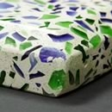
A r c h I t e c t u r e
Interior Tenant Fit out
Materials
Doors
Eggers Industry
FSC Certified
VOC Free
Tile
EnviroGLAS
Local Material
Recycled Glass
EcoTop
Bamboo Fiber
VOC Free
M i l e s t o n e B u i l d i n g # 4
K r i s t e n M H l o p i c k
Construction Management | Dr. David Riley | Germantown, Maryland | April 15, 2008

Slide 23
A r c h I t e c t u r e
Interior Tenant Fit out
Conclusion
Energy efficient
Environmentally friendly
Healthier work environment
Cost concerns
M i l e s t o n e B u i l d i n g # 4
K r i s t e n M H l o p i c k
Construction Management | Dr. David Riley | Germantown, Maryland | April 15, 2008

Slide 24
S t u r c t u r a l
Parking Garage
Technical Analysis II: Structural Breadth
Impervious Surface Parking vs. Parking Garage
M i l e s t o n e B u i l d i n g # 4
K r i s t e n M H l o p i c k
Construction Management | Dr. David Riley | Germantown, Maryland | April 15, 2008

Slide 25
S t u r c t u r a l
Parking Garage
Problem Statement
Impervious asphalt parking
Non-sustainable site
Restricts 3 LEED Sustainable Sites points
Goal
Sustainable site
Parking structure
Free space considerations
M i l e s t o n e B u i l d i n g # 4
K r i s t e n M H l o p i c k
Construction Management | Dr. David Riley | Germantown, Maryland | April 15, 2008

Slide 26
S t u r c t u r a l
Parking Garage
Procedure
Determine allowable site usage
Architectural Design
Structural Design
Cost analysis
Schedule impacts
M i l e s t o n e B u i l d i n g # 4
K r i s t e n M H l o p i c k
Construction Management | Dr. David Riley | Germantown, Maryland | April 15, 2008

Slide 27
S t u r c t u r a l
Parking Garage
Site Location
M i l e s t o n e B u i l d i n g # 4
K r i s t e n M H l o p i c k
Construction Management | Dr. David Riley | Germantown, Maryland | April 15, 2008

Slide 28
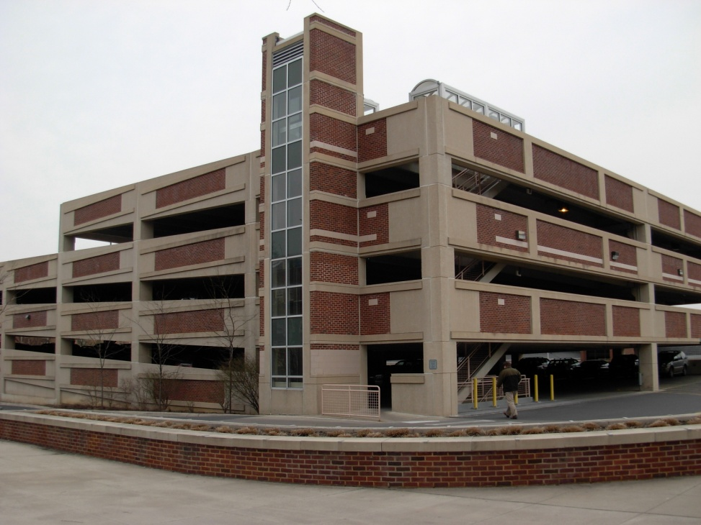
S t u r c t u r a l
Parking Garage
Architectural Design
M i l e s t o n e B u i l d i n g # 4
K r i s t e n M H l o p i c k
Construction Management | Dr. David Riley | Germantown, Maryland | April 15, 2008

Slide 29
S t u r c t u r a l
Parking Garage
Architectural Design
Level 1 and Entrance
Levels 2-6
Top Level
M i l e s t o n e B u i l d i n g # 4
K r i s t e n M H l o p i c k
Construction Management | Dr. David Riley | Germantown, Maryland | April 15, 2008

Slide 30
S t u r c t u r a l
Parking Garage
Structural Design
1
2
3
4
3
2
1
Double T’s
8DT24
L Beams
20LB24
Inverted T’s
28IT32
Columns
20X20
18X18
14X14
A
Double T’s
Inverted T Beams
L Beams
B
A
M i l e s t o n e B u i l d i n g # 4
K r i s t e n M H l o p i c k
Construction Management | Dr. David Riley | Germantown, Maryland | April 15, 2008

Slide 31
S t u r c t u r a l
Parking Garage
Cost
RS Means: $48.97/SF or $6,138,097
Nitterhouse Concrete Products:
 | Cost | Unit | Span (ft) | Width (ft) | Subtotal | Quantity | Total
Double T | $15.00 | SF | 58 | 8 | $6,960.00 | 256 | $1,781,760.00
L Beam | $250.00 | LF | 24 |  | $6,000.00 | 74 | $444,000.00
L Beam | $250.00 | LF | 32 |  | $8,000.00 | 50 | $400,000.00
Inverted T | $300.00 | LF | 24 |  | $7,200.00 | 11 | $79,200.00
14x14 | $39.00 | LF | 9 |  | $351.00 | 38 | $13,338.00
18x18 | $273.00 | LF | 9 |  | $2,457.00 | 9 | $22,113.00
20x20 | $415.00 | LF | 9 |  | $3,735.00 | 2 | $7,470.00
Total |  |  |  |  |  |  | $2,747,881.00
M i l e s t o n e B u i l d i n g # 4
K r i s t e n M H l o p i c k
Construction Management | Dr. David Riley | Germantown, Maryland | April 15, 2008

Slide 32
S t u r c t u r a l
Parking Garage
Schedule
Columns 3.75 days
Double T’s 16 days
L Beams 5.39 days
Inverted T 0.48 days
Total Duration: 33 working days (RS Means)
15 working days (Nitterhouse)
M i l e s t o n e B u i l d i n g # 4
K r i s t e n M H l o p i c k
Construction Management | Dr. David Riley | Germantown, Maryland | April 15, 2008

Slide 33
S t u r c t u r a l
Parking Garage
Conclusion
Sustainability benefits
Free space
Increase schedule
Increase cost
M i l e s t o n e B u i l d i n g # 4
K r i s t e n M H l o p i c k
Construction Management | Dr. David Riley | Germantown, Maryland | April 15, 2008
Notes:
$410,000 vs ~$6M

Slide 34
A c k n o w l e d g e m e n t s
AE Faculty
Buch Construction
Barks Daily – Nitterhouse Concrete
Jennifer Keating Dix – Trammell Crow
Ena Guido – Morgan Gick McBeath and Associates
Survey Consultants
AE Students
Family and Friends
M i l e s t o n e B u i l d i n g # 4
K r i s t e n M H l o p i c k
Construction Management | Dr. David Riley | Germantown, Maryland | April 15, 2008

Slide 35
M I l e s t o n e B u I l d I n g # 4

